Slide 1
Color

Slide 2
Color
When talking about color we use the terms ‘hue’, ‘value’ and ‘brightness’.
Hue: refers to the 6 true colors – red, orange, yellow, green, blue, and violet. These are primary and secondary colors you find on a color wheel.
Value: refers to how light or dark the color is.
Brightness: refers to the intensity of a color. How bright or dull is that color?

Slide 3
Primary Colors
The 3 primary colors are red, yellow and blue. They are called primary because you can’t mix any other colors to make these, but you can use these colors in different combinations to make other colors.
Yellow
Blue
Red

Slide 4
Secondary Colors
Violet
Green
Orange
Secondary colors are made by mixing two primary colors. Red and blue make violet, red and yellow make orange, and blue and yellow make green.

Slide 5
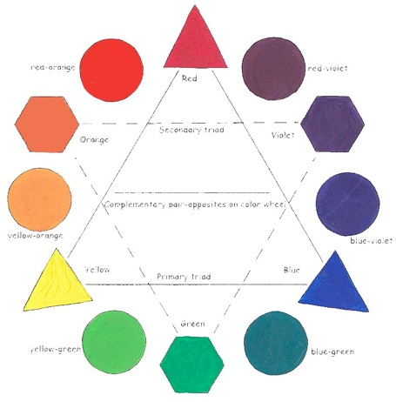
Color Wheel
The color wheel shows how to mix primary colors to make secondary colors. The arrangement of the colors on the wheel show the sequential relationship between the colors as you move around the wheel.

Slide 6
Tertiary Colors
Tertiary Colors are the colors made by combining one primary and one secondary color on the Color Wheel.

Slide 7
Complementary Colors
Complementary colors are two colors that are opposite on a color wheel, such as Red and Green. They are placed opposite because they do not share any basic primary colors.

Slide 8
Analogous Colors
Analogous colors are three or four colors that are next to each other on a color wheel such as yellow, yellow green and green. Analogous colors create a harmonious effect.

Slide 9
Tint & Shade
You can make a tint by adding white to a color. You can make a shade by adding black to a color.

Slide 10
Monochromatic Color Scheme
A monochromatic color scheme includes one color and its tints and shades. When you add white to a hue you achieve a tint. For example pink is a tint of red, because when you add red and white you get pink. When you add black to a hue you achieve a shade. Navy blue is a shade of blue, made by adding black to blue.

Slide 11
Color Value
We use the term Color Value to refer to the lightness or darkness of a color. This includes all the shades in between.

Slide 12
Color Intensity
Color Intensity refers to the brightness or dullness of a color. Brightness refers to a color in it’s most vivid degree. A bright color seems to jump out at you. Dullness refers to the color at it’s weakest or softest degree. Dull colors are more subtle than bright ones. Dull colors are made by mixing a color and its complement. Its opposite on the color wheel. For example you can make red dull by adding green to it.

Slide 13
Mood
We use art to create a mood, stimulating emotion in the person who is viewing the piece of art. We use color to create a mood. Look at the illustration at the illustration at the right. Half of the colors on the wheel are ‘warm’ colors and half are ‘cool’. These help us create a mood with art.

Slide 14
Warm Colors
Warm colors are associated with daylight or sunset. Warm colors are said to be the colors from Red to Yellow Green. Browns and tans are included into the Warm Color group. Warm colors are said to advance or be more active in artwork.

Slide 15
Cool Colors
Cool colors are associated with a gray overcast day or night time. Cool colors are the colors from green to red violet on the color wheel. Most grays are included into the cool color category. Cool colors tend to recede in art work and create a calming relaxed effect on the viewer.

