Slide 1
Lines Art Lesson

Slide 2
Line is an element of art defined by a point moving in space.

Slide 3
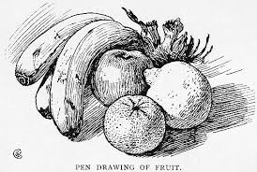
Some ways an artists can use line is to draw pictures, create pattern, make an outline, give the idea of mood. Can you think of other ways an artist might use lines?

Slide 4
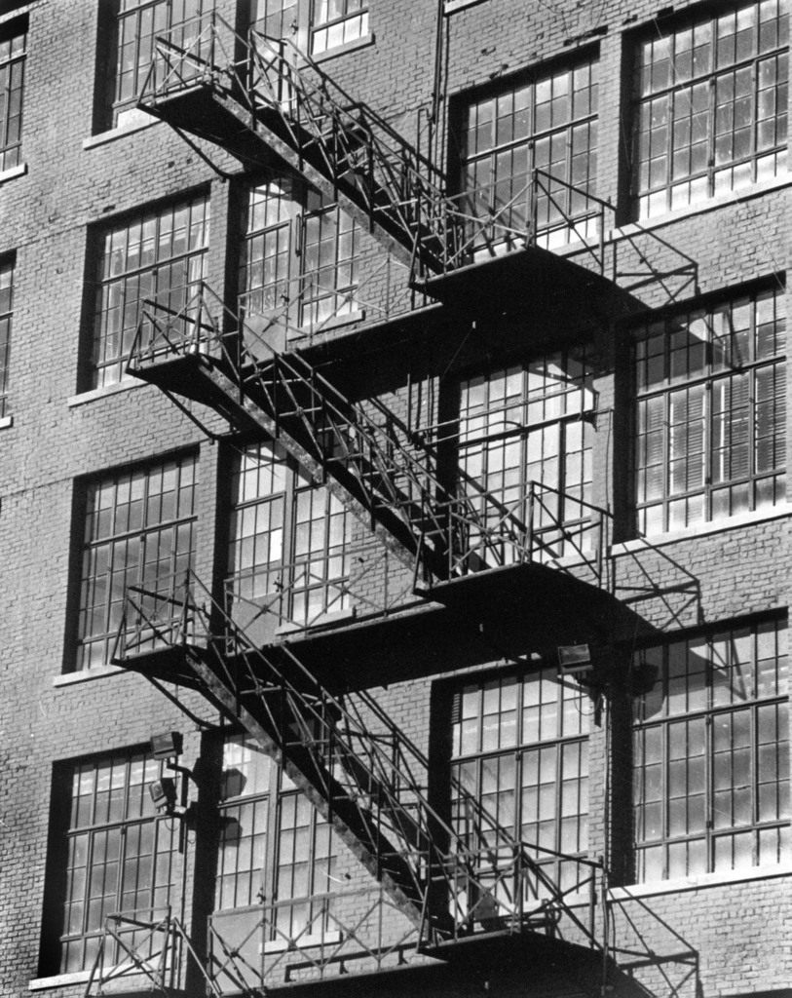
Diagonal Line

Slide 5
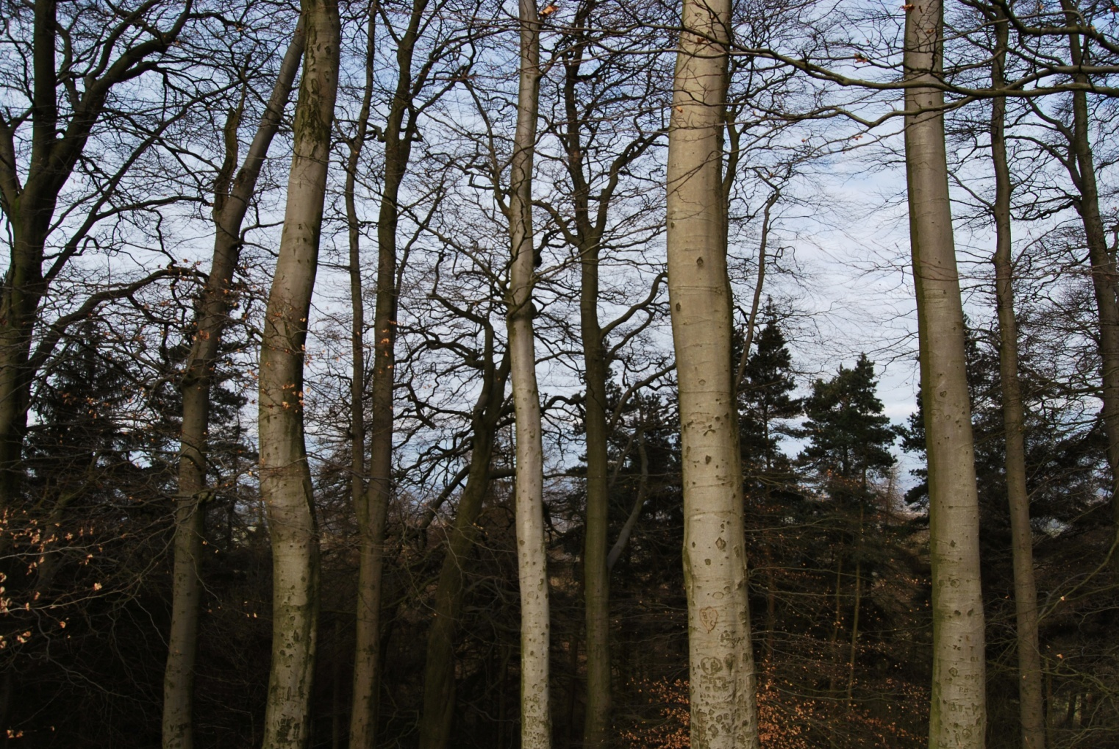
Vertical

Slide 6
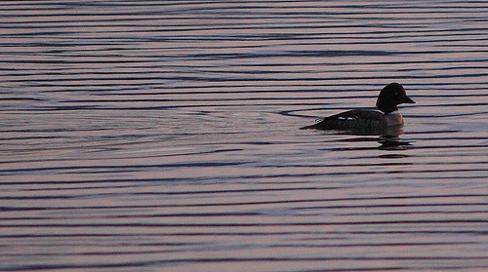
Horizontal

Slide 7
Thick

Slide 8
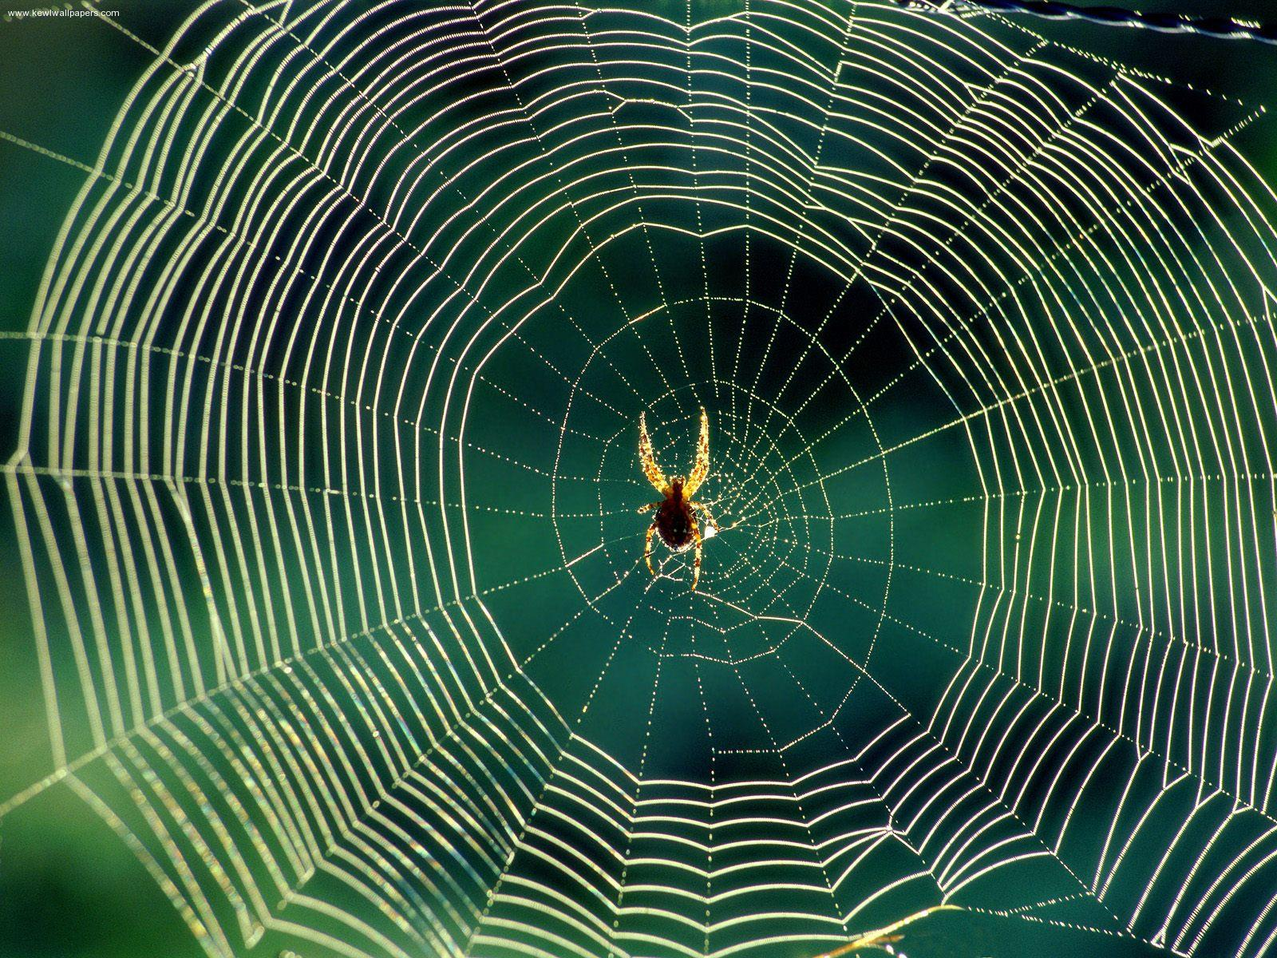
Thin

Slide 9
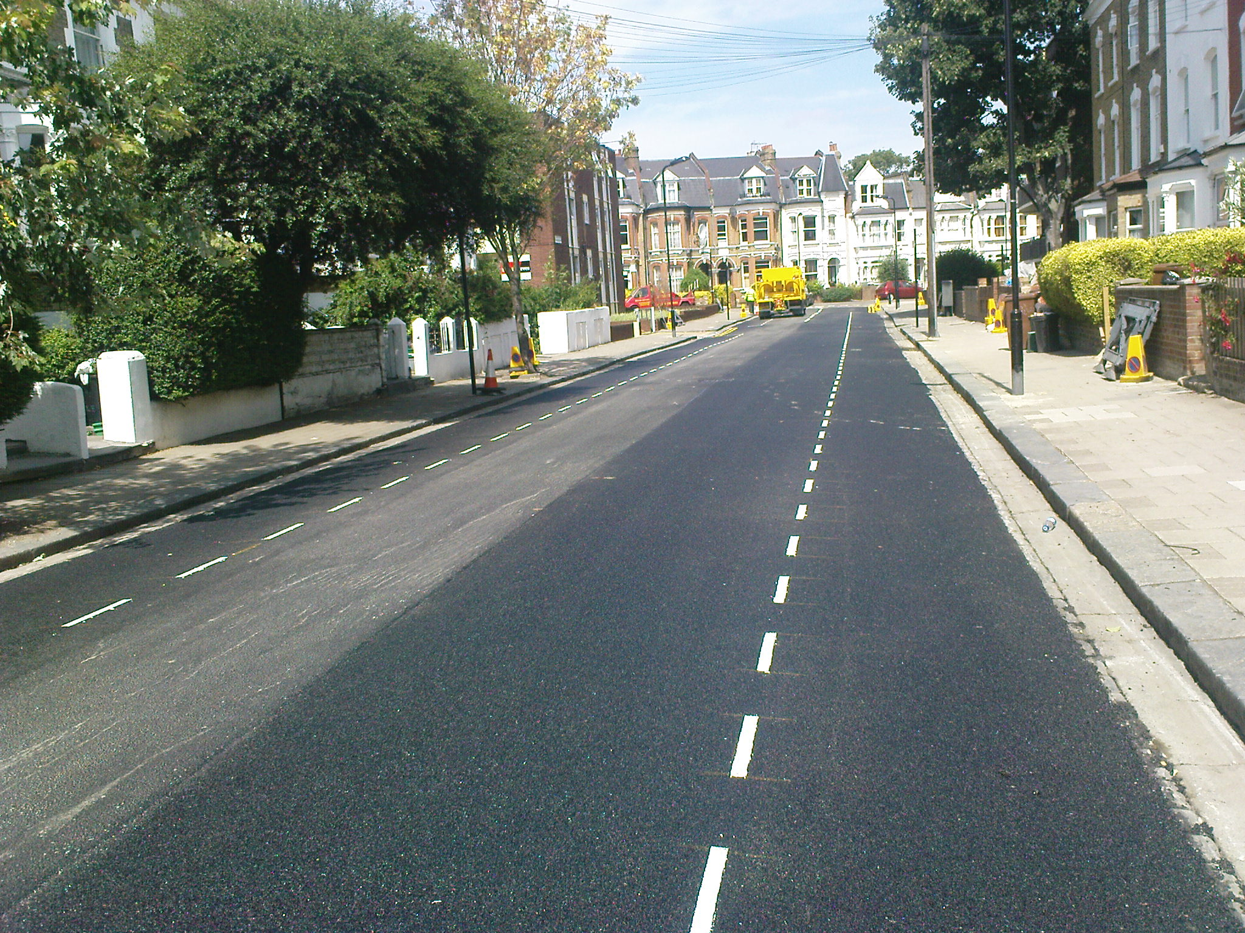
Broken

Slide 10
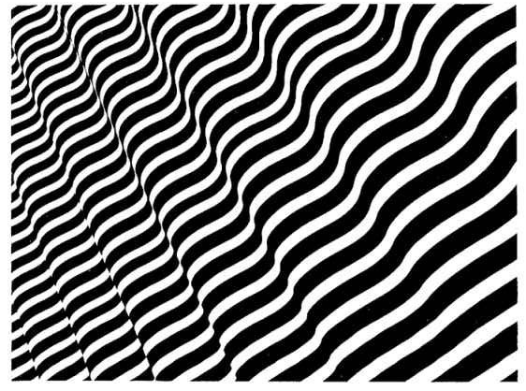
Wavy

Slide 11
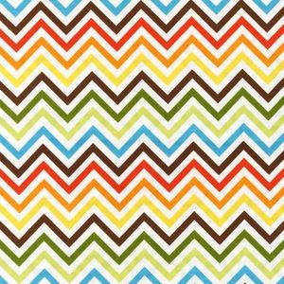
Zigzag

