Slide 1
Shapes

Slide 2
Shapes
A line drawn to enclose an area forms a shape. Shapes can be geometric or free form, and they can be contoured, positive, or negative within an artwork.

Slide 3
Shape Concepts
Geometric Shapes
Free Form/Organic Shapes
Contour of Shapes
Positive and Negative

Slide 4
Geometric Shapes
Geometric Shapes include both the basic mathematic shapes as well as the three dimensional shapes.

Slide 5
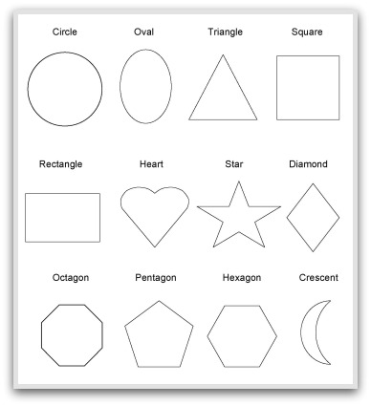
Basic Mathematical Shapes

Slide 6
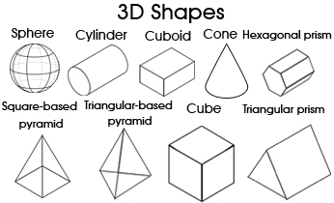
Three Dimensional Shapes

Slide 7
Free Form/Organic Shapes
Forms that have no distinct or definite shape. These can be creative, irregularly shaped and free-flowing.

Slide 8
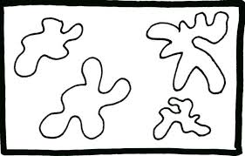
Free Form Shapes

Slide 9
Contour
The basic outline or edge of any given object.

Slide 10
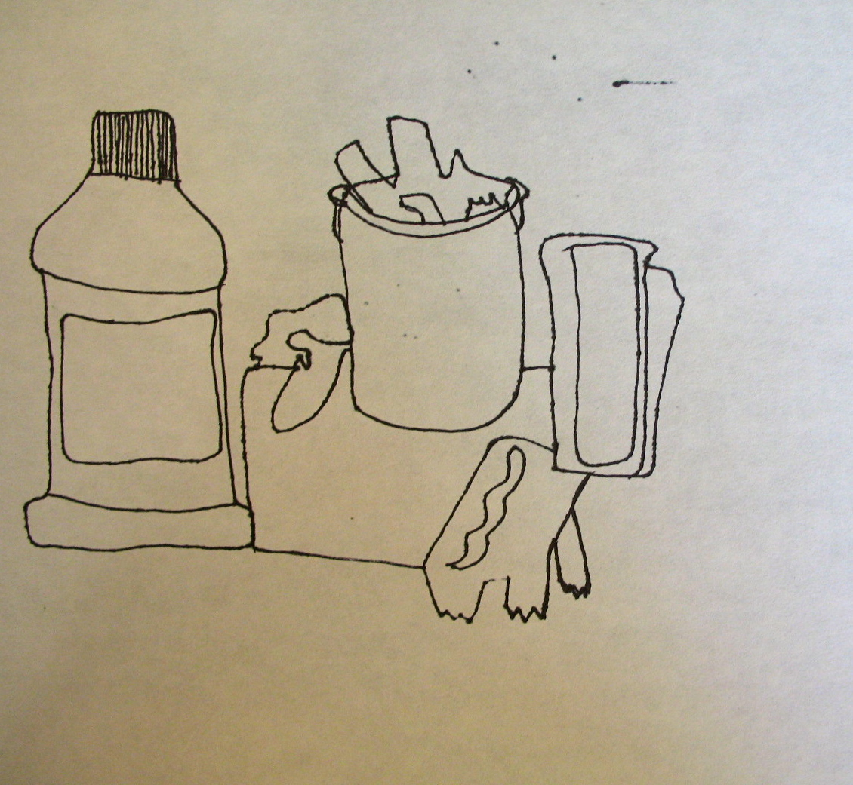
Contour

Slide 11
Positive and Negative
Positive shapes in a picture are those that are the main focus of the picture, while negative shapes are those that are lesson noticeable. Both are necessary to the complete picture.

Slide 12
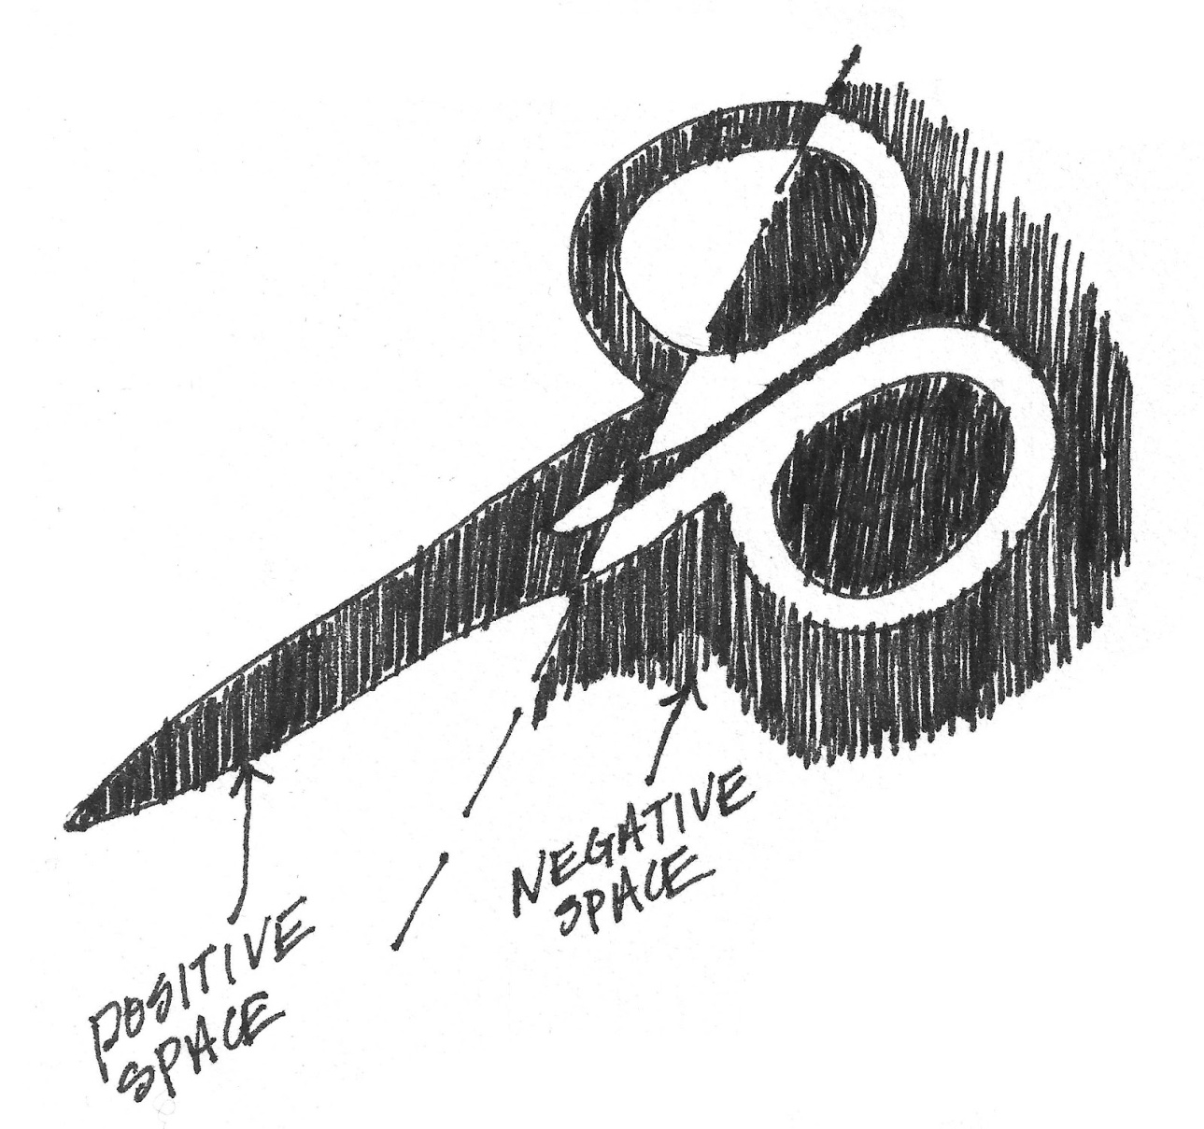
Positive and Negative Space

