Slide 1
Texture & Movement

Slide 2
The term texture refers to the surface of an object or artwork – how it looks and how it feels. In art texture is represented by creating a rough or smooth surface effect. This can be achieved by the use of repetition, spattering, rubbing or daubing techniques.

Slide 3
Repetition
Create a pattern in an artwork by repeating a line or a shape. The pattern becomes a textural effect.

Slide 4
Spattering
By spattering paint on the artwork with a toothbrush, paintbrusth or spray can, you can add specks or dots, which can become shapes.

Slide 5
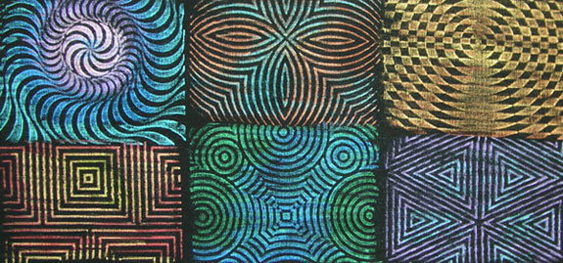
Rubbing
Place the artwork on a textured surface, such as a large rock. Using a pencil or crayon, rub over the paper until you have created the rock’s surface on the paper.

Slide 6
Daubing
Using a sponge or wad of paper soaked with paint, spot a piece of paper or an object, creating a painted effect.

Slide 7
Movement shows actions, or alternatively, the path the viewer's eye follows throughout an artwork. Movement is caused by using elements under the rules of the principles in picture to give the feeling of motion and to guide the viewer's eyes throughout the artwork. In movement an art should flow, because the artist has the ability to control the viewer's eye. The artists control what the viewers see and how they see it, like a path leading across the page to the item the artist wants the viewer's attention focused on.

Slide 8
Visual movement usually leads to a focal point.

Slide 9
Elongated shapes cause our eyes to move along them.

Slide 10
Our eyes tend to trace contours of forms moving along their edges.

